Slide 1

ALMABETTER
Functions in JavaScript: Part-2

Slide 2



Welcome to the Class
All additional code resources can be found at https://drive.google.com/drive/folders/1zvwgdokSqRcl8uvQZD1FHP6APxMR2di9?usp=sharing
Kindly be ready with code environment or IDE of your choice for trying out exercises. I would be using VS code but you are free to pick the one of your choice.
Please go through the course resources once we’re done to revise the concepts and cover up any theoretical stuff.
In case you have any doubts understanding any specific area, feel free to drop a message in the chat and I would respond immediately after I look at that.
Know about me at https://shivamsahil.web.app

Slide 3
What will we cover today ?
Quick Recap
Function Expressions
Types of Functions
Function execution
Call Stack
JavaScript Hoisting

Slide 4
Pre-Requisites
Functions
Function Declaration
Calling a Function
Parameters and Arguments
Default Parameters
Function Return
Helper Functions

Slide 5
Quick Recap

Slide 6
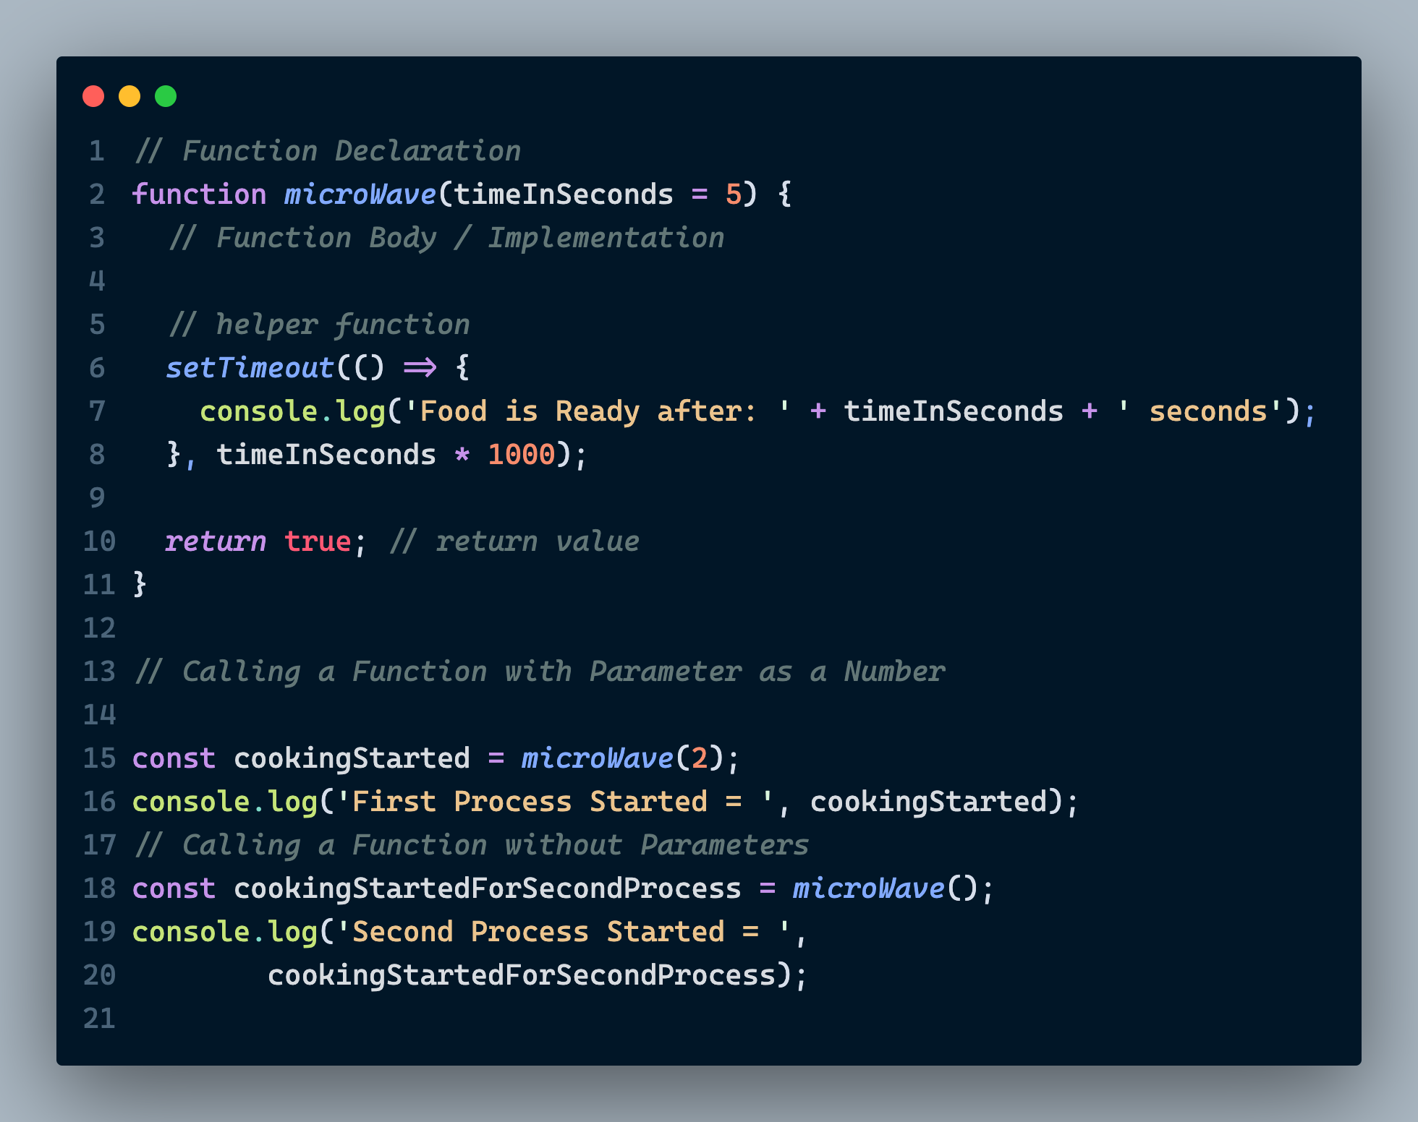
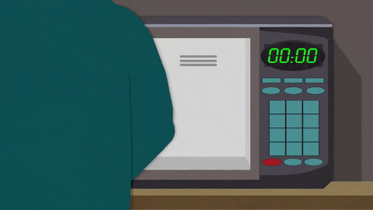
Quick Recap : Functions

Slide 7
Function Expressions

Slide 8
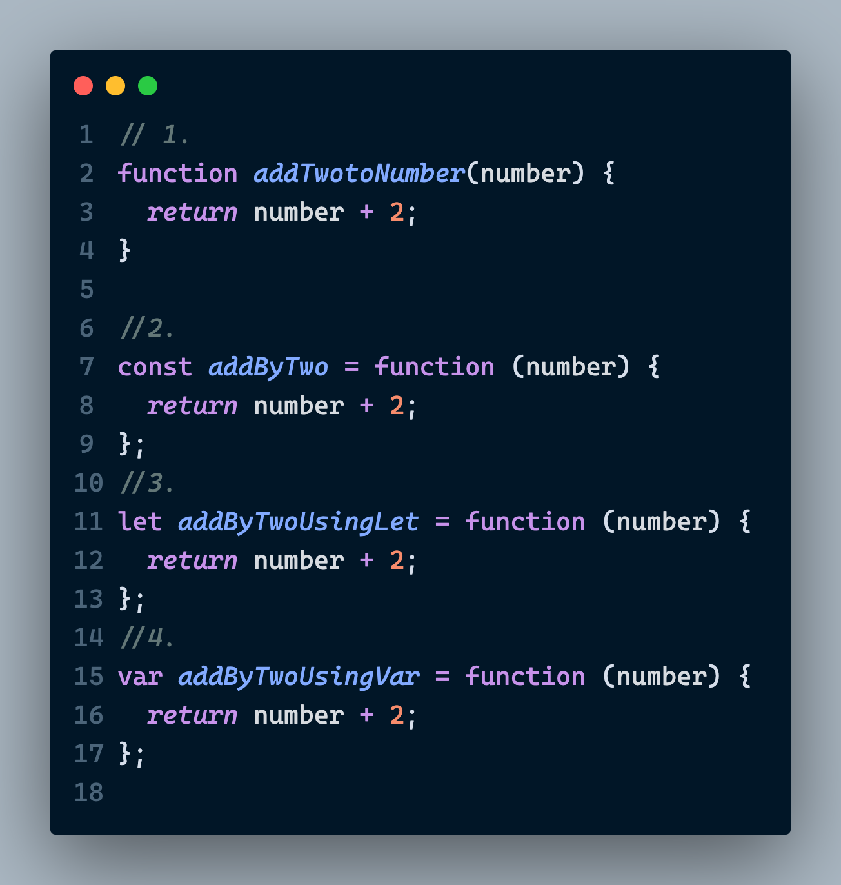
Function Expressions

Slide 9
Types of Functions

Slide 10
Types of Functions
Arrow Functions
Anonymous Functions

Slide 11
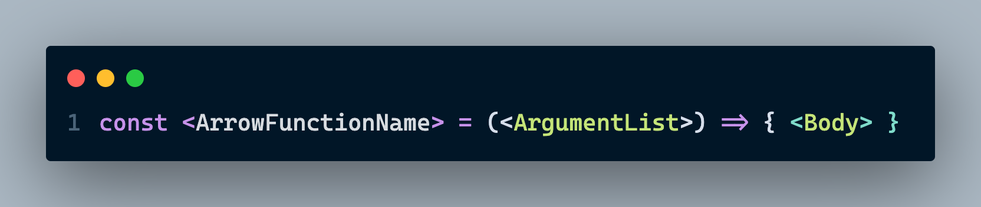
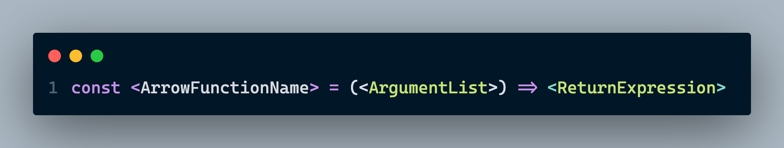
Arrow Functions

Slide 12
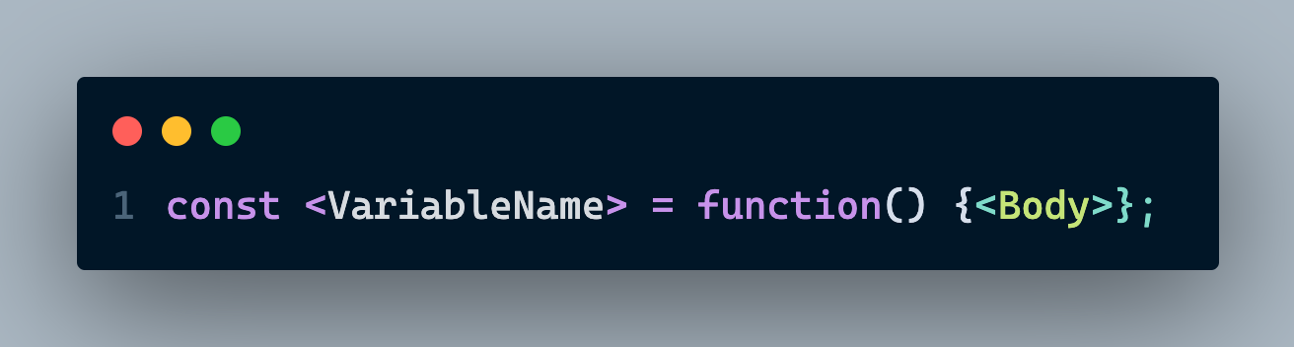
Anonymous Functions
Anonymous Function implementation of Arrow function
Widely used in Array Methods

Slide 13
Call Stack in JavaScript

Slide 14
Call Stack in JavaScript
Arrow Functions
Anonymous Functions

Slide 15
What happens when we run a JS code ?
Initialization and Memory Allocation
Execution

Slide 16
Four Golden rules of Initialization
Any variable that’s defined using var keyword would be initialized with a value undefined
Like many other data types, undefined is a datatype in JavaScript
Any function that’s declared using function keyword would be initialized with all its implementation even if its declaration is done at the end.
Any other initialization that doesn’t follow the above two would be initialized only at run time. (Ex: let, const etc.)
While creating a new context of another function, any argument that is to be passed in the function also gets initialized as undefined.
If the execution reaches end of the code or a return statement, current context is completely destroyed.

Slide 17
Understanding Event Loop
JavaScript Runtime
Thread Pool | Web API
Memory Heap
Call stack
JavaScript
Main Thread

Slide 18
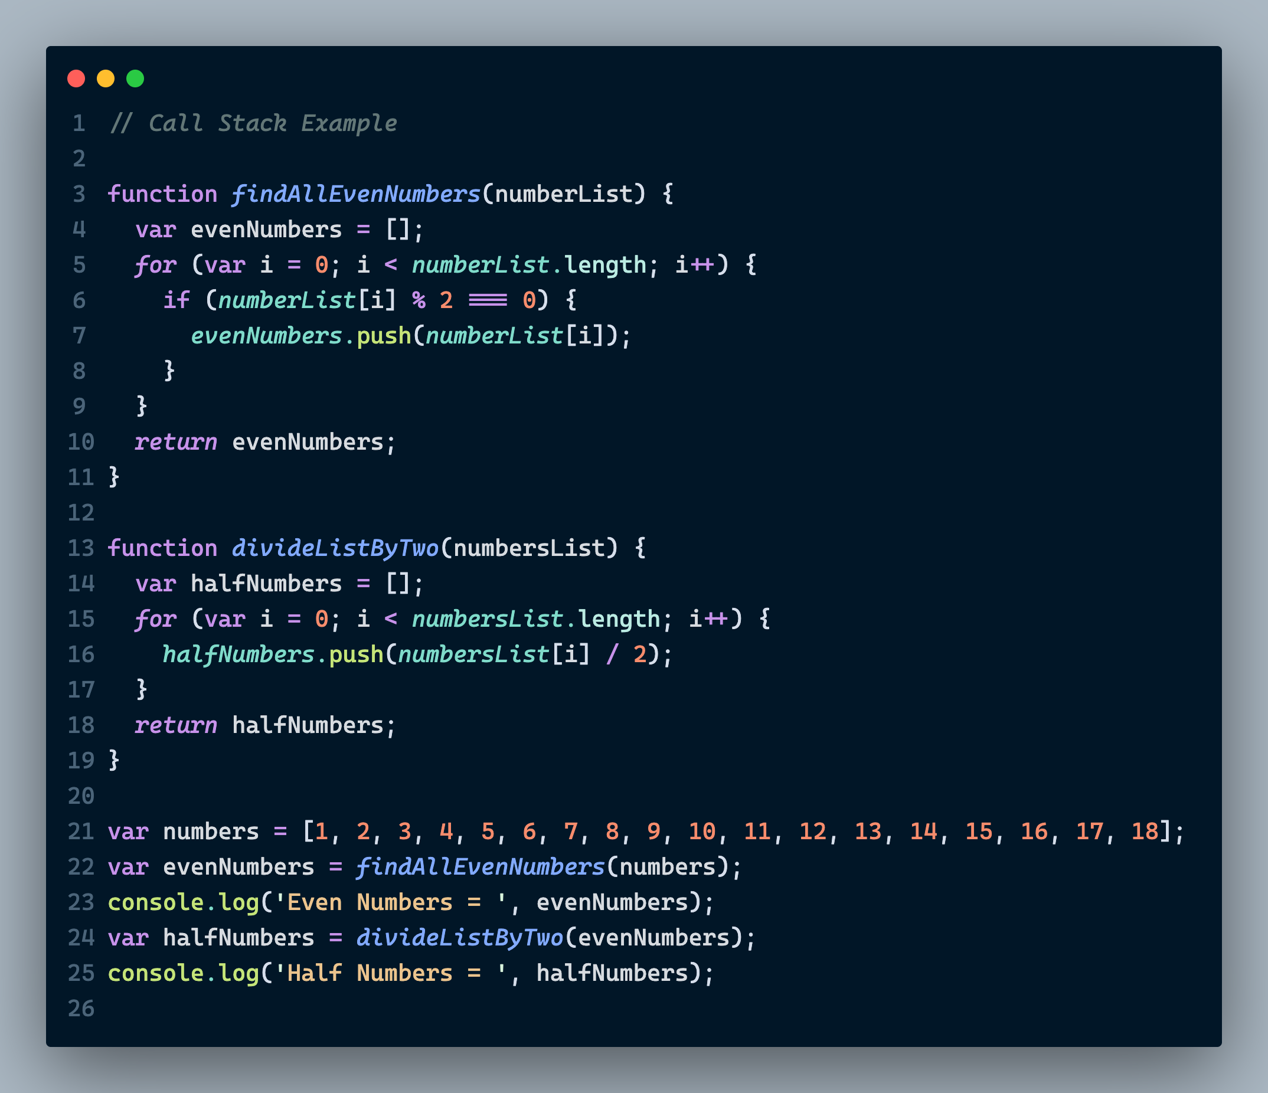
Example Code

Slide 19
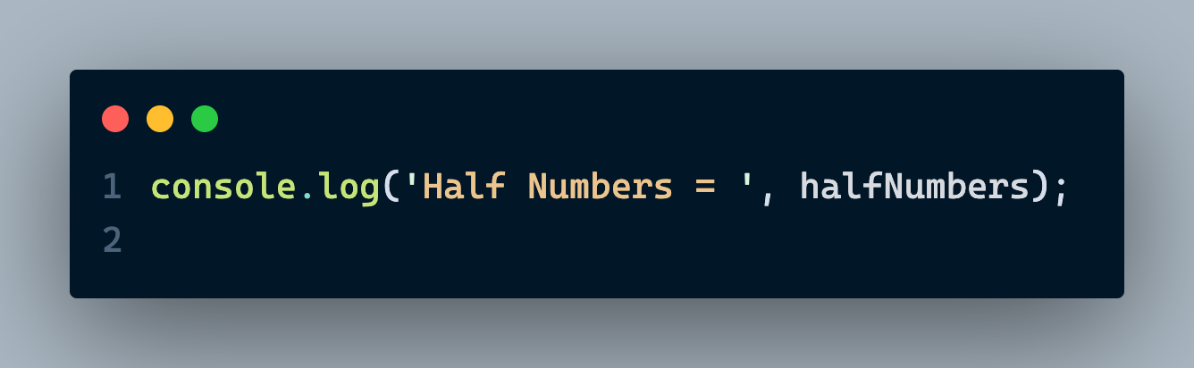
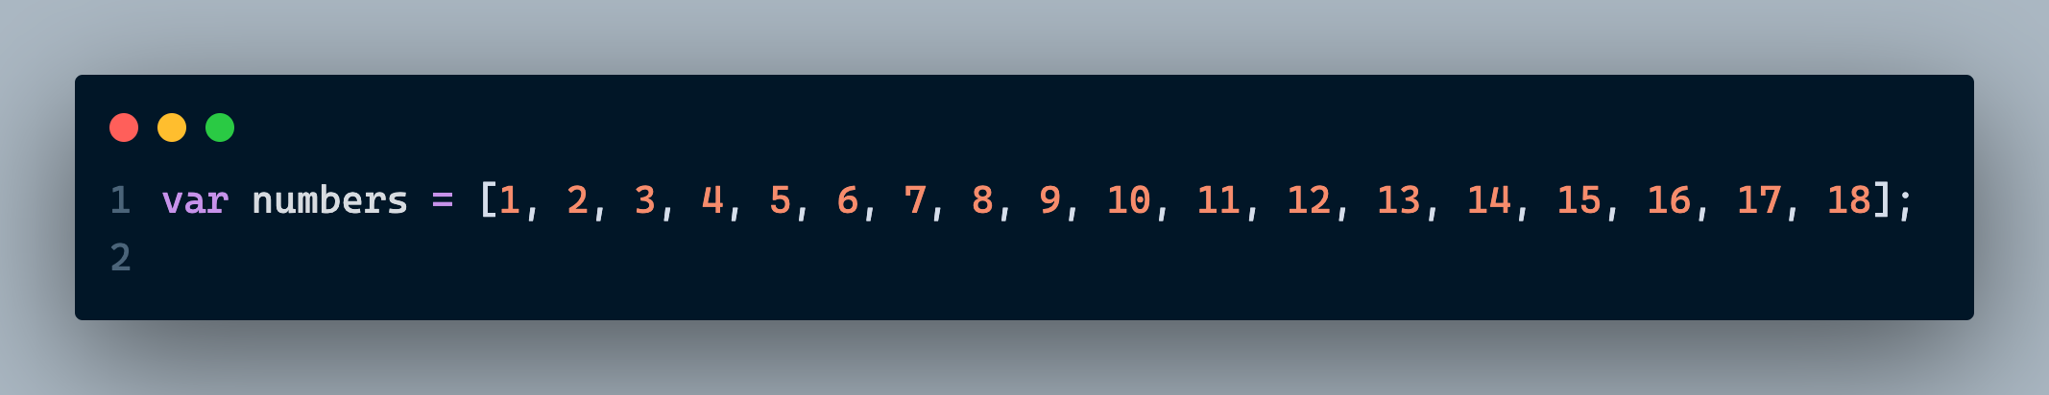
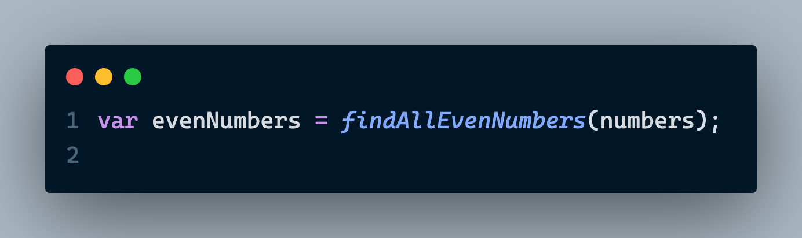

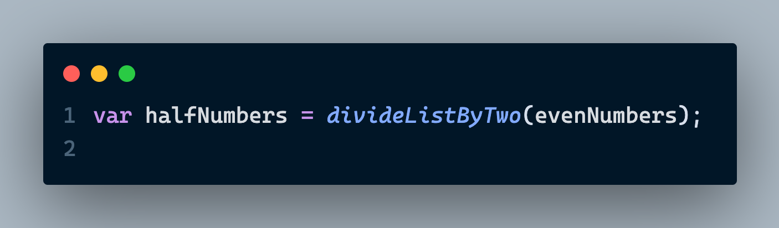
Understanding Event Loop: Initialization
JavaScript Runtime
Thread Pool | Web API
Memory Heap
Call stack
var i:undefined
var i: undefined
var halfNumbers:undefined
var evenNumbers: undefined
var numberList: undefined
var numberList: undefined
var halfNumbers: Array[]
var halfNumbers: undefined
JavaScript
Main Thread
var evenNumbers: undefined
var evenNumbers: Array[]
var Numbers: undefined
var Numbers: Array[]
findAllEvenNumbers: f()
divideListByTwo: f()
divideListByTwo: f()
findAllEvenNumbers: f()
anonymous: f()

Slide 20
Hoisting in JavaScript

Slide 21

Hoisting Real Life Example

Slide 22
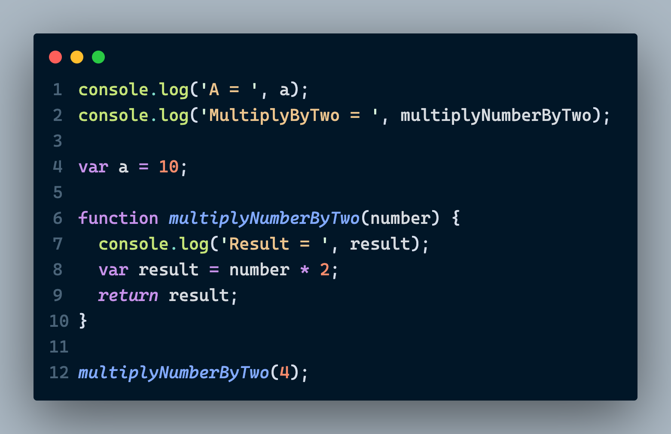
Hoisting in JavaScript: Example 1

Slide 23
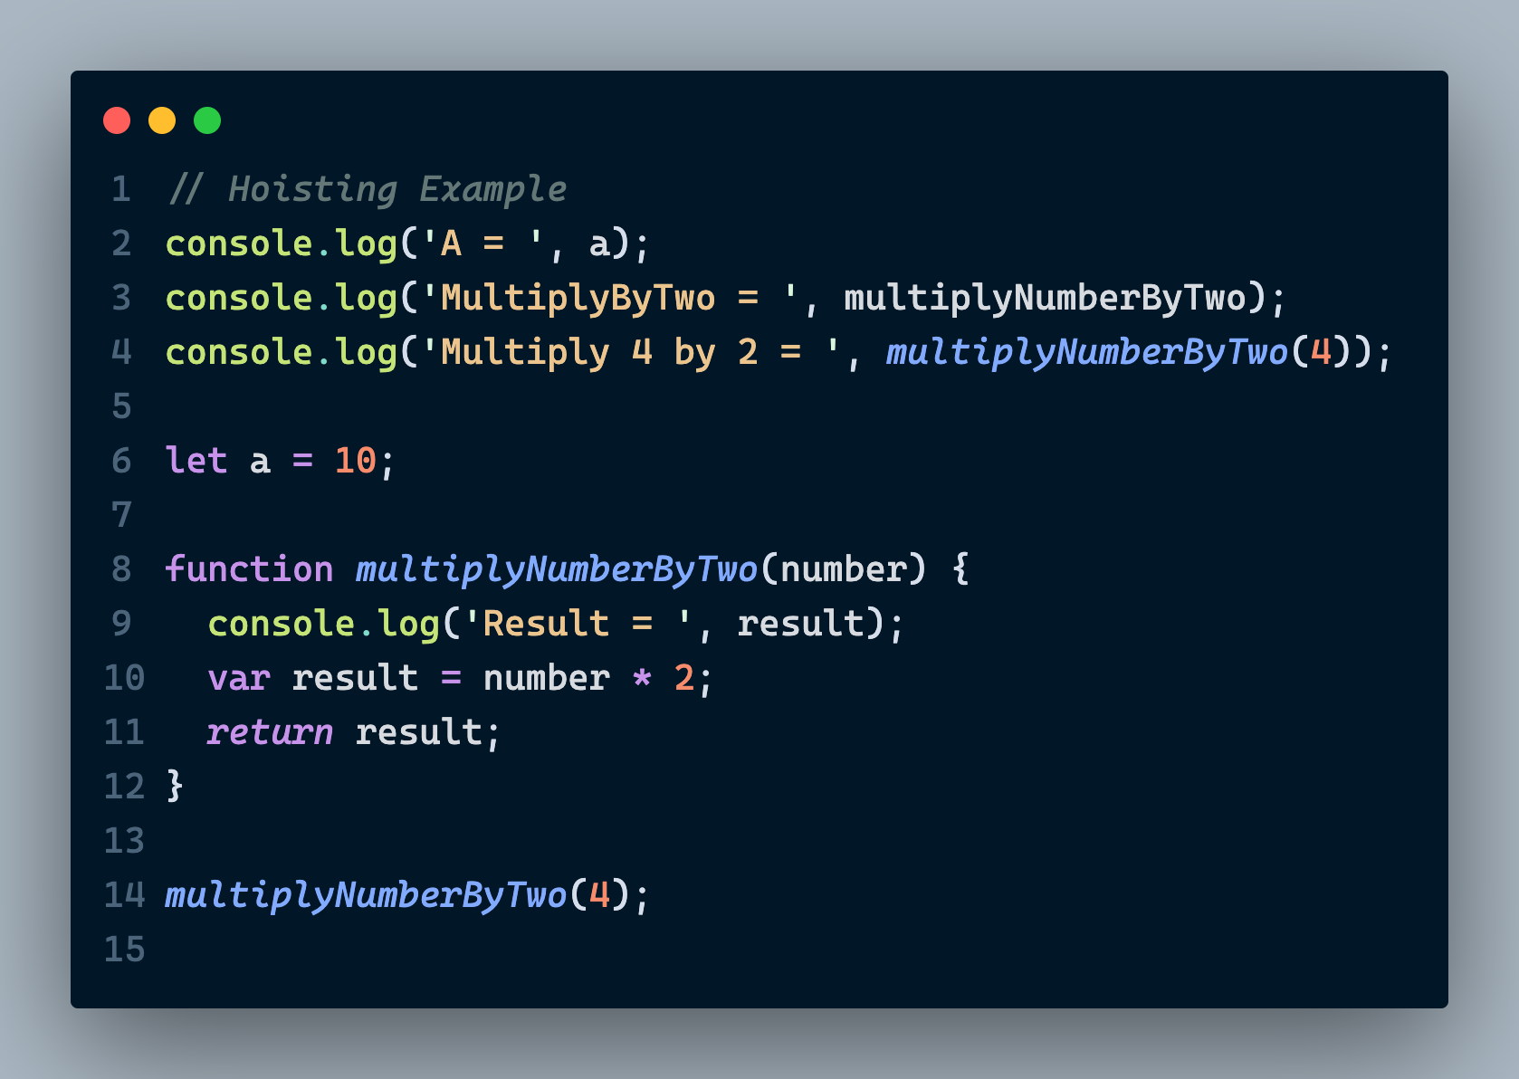
Hoisting in JavaScript: Example 2

Slide 24
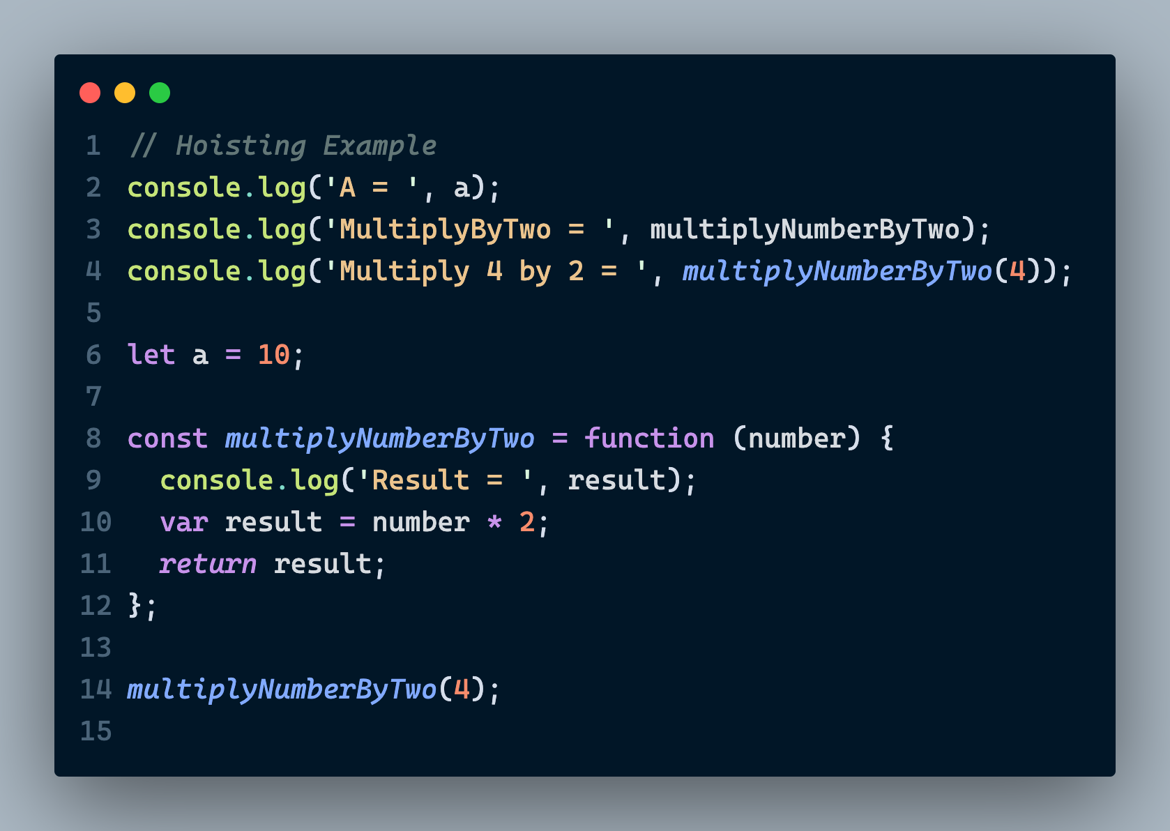
Hoisting in JavaScript: Example 3

Slide 25
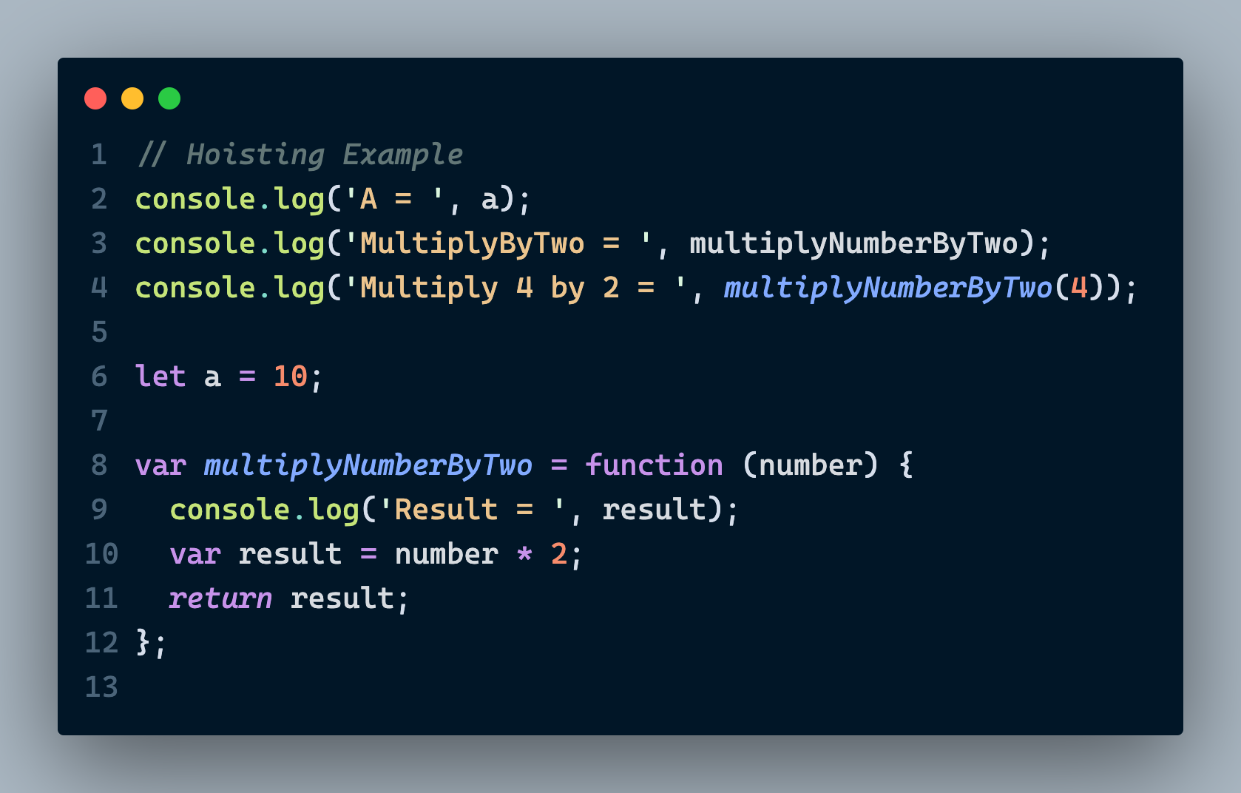
Hoisting in JavaScript: Example 4

Slide 26
Thank You For the Attention
Any Questions ?
~ Shivam Sahil
[Reach me at https://shivamsahil.web.app]

